Slide 1
Structures
CSE 105
Structured Programming Language (C)
Presentation - 6

Slide 2


Structure Basics (K^{n}R 6.1)
Why structure?
  Semantically related variables grouped together.
  Treat a group of related variables as a single entity.
  One step towards Object Oriented Programming
Structures may be:
  Assigned to other structures.
  Passed to functions
  Returned by functions
  Nested into other structures
  Accessed by pointers
  Placed into arrays.

Slide 3
Structure Examples (K^{n}R 6.1)
struct point { // declaration
int x;
int y;
};
struct point pt; // definition
struct point { // declaration & defition
int x;
int y;
} pt1;
struct point pt2 = { 320, 240 }; // initialization
struct rect { // nested structure
struct point pt1;
struct point pt2;
} screen;
pt.x = 120; // accessing member
pt.y = pt2.y-20; // accessing member
screen.pt1.x = (pt1.x+pt2.x)/2; // scope of members
struct name {
type1 member1;
type2 member2;
… … …
typen membern;
} var1, var2, … ;
pt.x
120
pt.y
220
pt1.x
?
pt1.y
?
pt2.x
320
pt2.y
240
screen.pt1.x
?
screen.pt1.y
?
We use typedef to get rid of typing struct with every declaration.
screen.pt2.x
?
screen.pt2.y
?

Slide 4

Structure Operations (K^{n}R 6.2)
Only legal operations on a structure are
  copying it as unit.
    assigning it with =
    passing as function argument
    returning values from functions
  taking its address with &
  accessing its members with . or ->

Slide 5
Structures and Functions
Structures, just like scalar datatypes e.g. int, long etc., can be passed by value or returned.
struct rect screen;
struct point middle, makepoint(int, int);
screen.pt1 = makepoint(0, 0);
screen.pt1 = makepoint(1024, 786);
middle = makepoint((screen.pt1.x+screen.pt2.x)/2,
(screen.pt1.y+screen.pt2.y)/2);
/* makepoint: make a point from x and y components */
struct point makepoint(int x, int y) {
struct point temp;
temp.x = x;
temp.y = y;
return temp;
}

Slide 6

Structures and Functions
Stack
/* addpoint: add two points */
struct point addpoint(struct point p1, struct point p2) {
p1.x += p2.x;
p1.y += p2.y;
return p1;
}
void printpoint(char *name, struct point p) {
printf(“%s.x=%d, %s.y=%d\n”, name, p.x, name, p.y);
}
struct point pt1 = makepoint(10, 20);
struct point pt2 = makepoint(30, 40);
struct point pt3 = addpoint(pt1, pt2);
printpoint(“pt1“, pt1);
printpoint(“pt2“, pt2);
printpoint(“pt3“, pt3);
p1:
10
40
20
updates in p1 changes the copy in stack
60
p2:
30
on return p1 is copied back to pt3
40
pt1 and pt2 are copied to stack
pt1:
10
pt3:
20
40
60
pt2:
30
40

Slide 7
Pointers as Field in Structures
For char *word, only the pointer is stored in the structure but the actual string (i.e., char array) is stored somewhere else.
struct key {
char *word;
int count;
};
struct key k1 = {“test”, 10};
struct key k2 = k1;
k1
test\0
10
k2
10
If you try to use fwrite to write this structure then only the pointer (2 bytes) to the string and the count will be stored in the file.
The string pointed to by word will not be copied to file.
You have to explicitly copy the string.

Slide 8
Array of Structures
Write a program to count the occurrences of C keywords
struct key {
char *word;
int count;
} tab[ ] = {
{“auto”, 0},
{“break”, 0},
{“case”, 0},
{“char”, 0},
{“const”, 0},
{“continue”, 0},
{“default”, 0},
/* . . . */
{“unsigned” , 0},
{“void”, 0},
{“volatile”, 0},
{“while”, 0}
};
key[0]
auto\0
0
[1]
break\0
0
[2]
case\0
0
[??]
while\0
0

Slide 9

Array of Structures
Searching for a keyword in keytab?
  You can use a for loop and check each element one by one.
  More efficient is to use binary search on sorted array!
int binsearch(char *word, struct key tab[], int n)
{
int cond, low, high, mid;
low = 0;
high = n – 1;
while (low <= high) {
mid = (low+high)/2;
if ((cond = strcmp(word, tab[mid].word) < 0)
high = mid – 1;
else if (cond > 0)
low = mid + 1;
else
return mid;
}
return -1;
}
low
3
5
6
9
12
mid
16
17
20
22
23
25
high
28

Slide 10
Pointer to Structure
/* Like other pointers, pointer to
structure takes 2/4 bytes */
struct point *pp, origin = {10, 10};
pp = &origin;
printf(“Origin is (%d,%d)\n”, (*pp).x, (*pp).y);
printf(“Origin is (%d,%d)\n”, pp->x, pp->y);
struct rect r, *rp;
rp = &r;
/* these four are same as . and -> are associative from left to right */
r.pt1.x
rp->pt1.x
(r.pt1).x
(rp->pt1).x
pp->x is short for (*pp).x
Note: *pp.x means *(pp.x)

Slide 11
Self-referential Structure
A structure that can point to itself
Example: a linked list of numbers
/* Type declaration, note the use of t_node and node*/
typedef struct t_node {
int x;
struct t_node *next;
} node;
node *pn;
node nd;
/* Alternate */
typedef struct t_node node;
struct t_node {
int x;
node *next;
};
node *pn;
node nd;

Slide 12
Linked List
They can be of many forms:
  One way Vs. Two way
  With or without dummy head
  Linear Vs. Circular
We will look at one way, linear Linked list with dummy head.
typedef struct t_node {
int x;
struct t_node *next;
} node;
x
next
head
dummy
Empty list
head
dummy
node1
node2
node3
List with
3 nodes

Slide 13
Linked List: Maintenance
/* Creates a new node, initializes it and returns */
node *ll_new(int x) {
node *pn = (node *) malloc(sizeof(node));
if (pn == 0)
return 0;
pn->x = x;
pn->next = 0;
return pn;
}
/* Deletes a node from memory */
void ll_delete(node *pn) {
if (pn != 0)
free(pn);
}
/* In main function. Creating an empty list */
node *head = ll_new(0);
head
dummy
Empty list

Slide 14
Linked List: Insertion
/* Inserts node pn after pred */
node *ll_insert(node *pred, node *pn) {
if (pred == 0 || pn == 0)
return 0;
pn->next = pred->next;
pred->next = pn;
return pred;
}
/* In main function. Creating an empty list */
node *head = ll_new(0);
/* Insert 3 elements at the beginning of the list */
ll_insert(head, ll_new(20));
ll_insert(head, ll_new(40));
ll_insert(head, ll_new(60));
pn
head
dummy
pred

Slide 15
Linked List: Searching
/* find a node having value x after pred */
node *ll_dfind(node *pred, int x) {
if (pred == 0 || pred->next == 0)
return 0;
for ( ; pred->next != 0; pred = pred->next)
if (pred->next->x == x)
return pred;
return 0;
}
/* find a node at index position i (1-based)*/
node *ll_ifind(node *pred, int i) {
if (pred == 0 || pred->next == 0)
return 0;
for ( ; i > 1 && pred->next != 0; i--, pred = pred->next)
;
return i == 1 ? pred : 0;
}

Slide 16
Linked List: Deletion
/* removes pred->next from list (not from memory) */
node *ll_remove(node *pred) {
node *pn;
if (pred == 0 || pred->next == 0)
return 0;
pn = pred->next;
pred->next = pred->next->next;
return pn;
}
node *pn, *pred;
/* Delete the node with value 36 */
if ((pred = ll_dfind(head, 36)) != 0) {
pn = ll_remove(pred);
ll_delete(pn);
}
/* Delete the node at 3rd position */
if ((pred = ll_ifind(head, 3)) != 0) {
pn = ll_remove(pred);
ll_delete(pn);
}
head
dummy
pred
pred->next
pn

Slide 17
Binary Search Tree

Slide 18

Binary Search Tree
Problem: Count the occurrences of all the words in input
Solution:
  Sorted array:
    Put the words in a sorted array as they arrive
    You have shift all the words greater than the word to inserted by one position
    This requires O(n²) operations, n is the number of word. E.g., for 10,000 word we need about 100,000,000 operations
  BST:
    Explained in following slides
    This requires O(nlog₂n) opeations. E.g., for 10,000 word we need about 10,000×log₂10,000 ≈ 133,000 operations

Slide 19
BST
At any node
  Left subtree has smaller words and
  Right subtree has larger words
Example: build a BST using following sentence
  now is the time for all good men to come to aid of their party.
now
is
the
for
men
of
time
all
good
party
their
to
aid
come

Slide 20
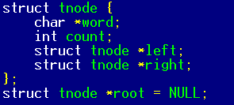
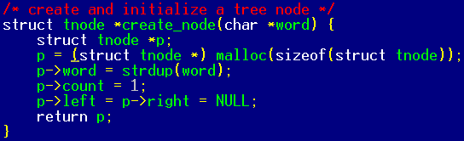
BST: Implementation
word
count

Slide 21
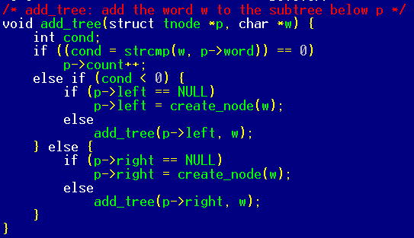

BST: Implementation (simple version)

Slide 22
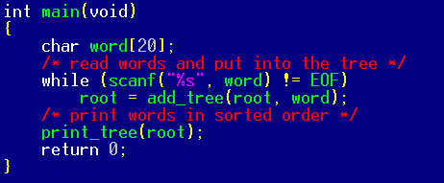
BST: Implementation
word
count

Slide 23
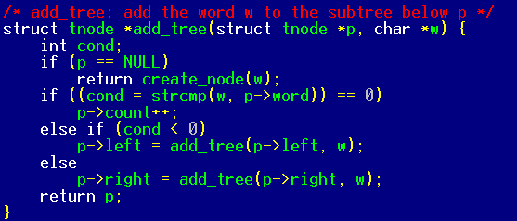
BST: Implementation
add_tree(p)
p->left = add_tree(p->left)
add_tree(p->left)
return p->left
If p->left != NULL
add_tree(p)
p->right = add_tree(p->right)
add_tree(p->right)
return p->right
If p->right != NULL

Slide 24
BST: Implementation
add_tree(p)
p->left = add_tree(p->left)
If p->left == NULL
add_tree(null)
return create_node
word
count
X
word
count
X
X

Slide 25
BST: Implementation
add_tree(p)
p->right = add_tree(p->right)
add_tree(null)
return create_node
If p->right == NULL
word
count
x
word
count
X
X

Slide 26
BST: Implementation
Stack
Root
R
R
X
now
to
is
the
for
men
time
all
good
to

Slide 27
BST: Implementation
Stack
Root
L
L
L
X
now
come
is
the
for
men
time
all
good
to
come

Slide 28
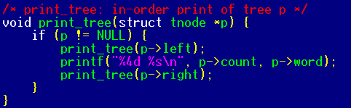
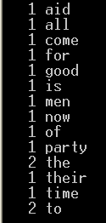

BST: Implementation
1 aid
1 all
1 come
1 for
1 good
1 is
now
is
the
for
men
of
time
all
good
party
their
to
aid
come

Slide 29
Tree Traversals
In-order
  Left child
  Self
  Right child
Pre-order
  Self
  Left-child
  Right-child
Post-order
  Left child
  Right child
  Self
word
count
word
word
count
count
word
count
word
word
count
count
word
count
word
word
count
count

